Slide 1
Deep in the thousand world!
Logical math intelligence

Slide 2
4.723 + 4.357
4000+700+20+3
4000+300+50+7

Slide 3
Criteria
01
02
03
Recognizes the number value for thousands
Proposes strategies to achieve a goal
Uses feedback for self improvement

Slide 4

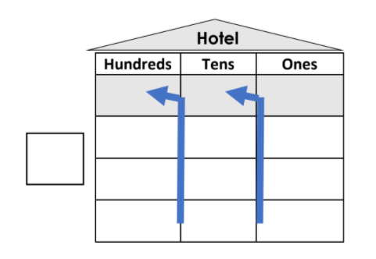

MATERIALS
Hotel value chart
Pencil
Eraser

Slide 5
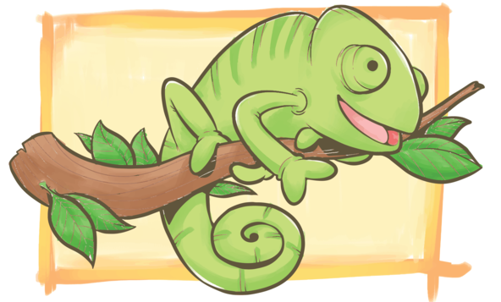

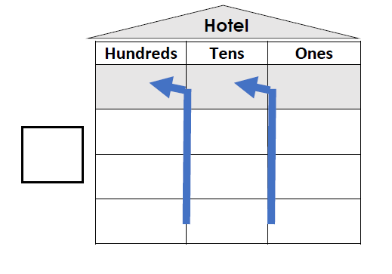
Extra Rooms
Top Rooms
Bottom Rooms
Entrance

Slide 6
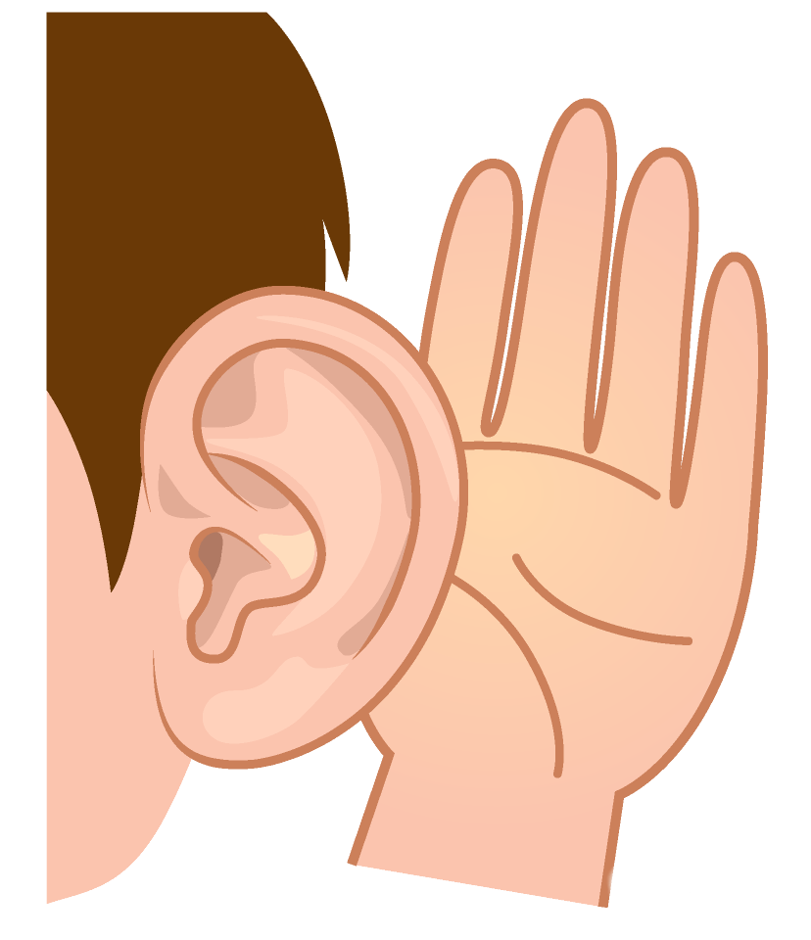

Listen to the example
-SOMEONE FAMOUS

Slide 7
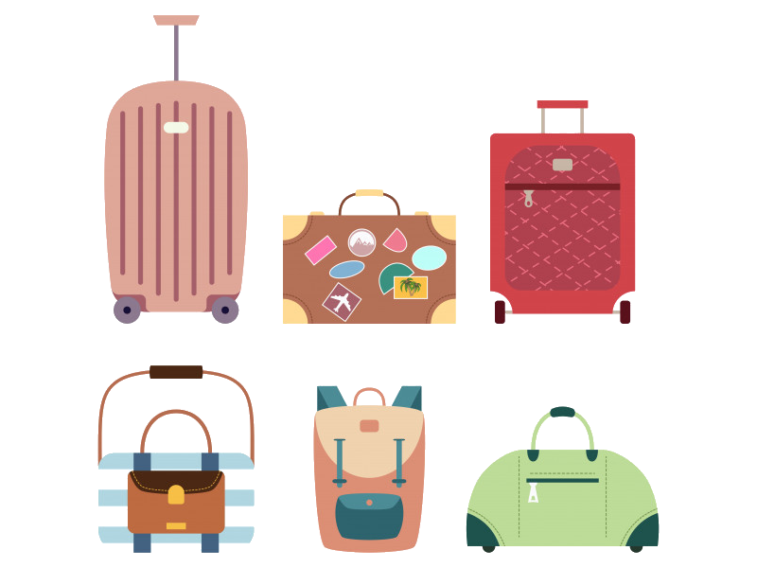
One day, the numbers 397 and 455
want to live at the Chameleons Hotel

Slide 8

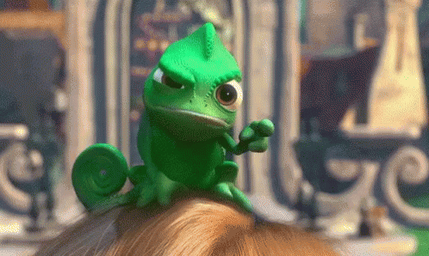
The Bellboy says: “Only one digit per room”

Slide 9
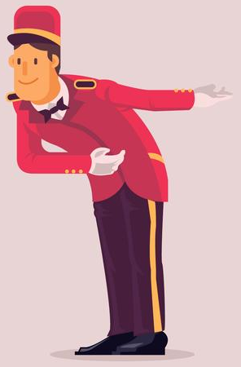
Another Bellboy says:
“The biggest number go to the top rooms”

Slide 10
The biggest number is
They go to the top rooms

Slide 11
The digits go to their rooms

Slide 12
The smallest number is
They go to the bottom rooms

Slide 13
The digits go to their rooms

Slide 14
¡The numbers check the rooms and there is more than 1 digit in the rooms!

Slide 15

Add the addition symbol to find the extra digits

Slide 16
The ones count and the new number has two digits: 12

Slide 17
The Bellboy say: “Only one digit per room”

Slide 18
Number: 12
The one stays at the entrance

Slide 19
Number: 12
The ten uses
the elevator to go to the tens extra room

Slide 20
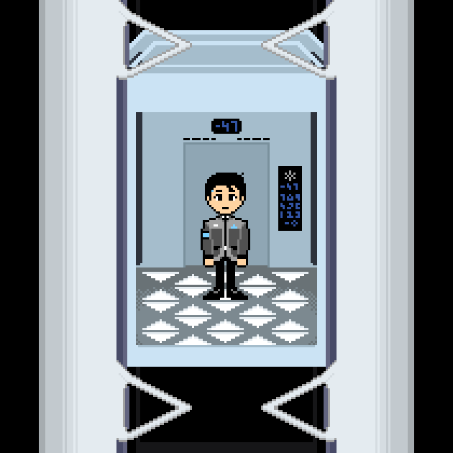


Slide 21
The tens count and the new number has two digits: 15

Slide 22
The Bellboy say: “Only one digit per room”

Slide 23
Number: 15
The one stays at the entrance

Slide 24
Number: 15
The ten uses
the elevator to go to the hundreds extra room

Slide 26
The hundreds count and the new number has one digit: 8

Slide 27
The Bellboy say: “Only one digit per room”

Slide 28
The one stays at the entrance

Slide 29
This is the regrouping process in additions

Slide 30
Now, it’s your turn

Slide 31
One day, the numbers 589 and 273
want to live at the Chameleons Hotel

Slide 32
Write the
numbers in their rooms
and do the addition

Slide 33
Answer

Slide 34
One day, the numbers 1.768 and 3.146
want to live at the Chameleons Hotel
.
.

Slide 35
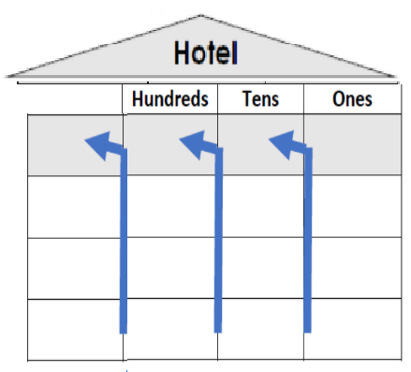
Write the
numbers in their rooms
and do the addition
.
.
Thousands
Hundreds
Tens
Ones

Slide 36
Answer
Thousands
Hundreds
Tens
Ones

Slide 37
One day, the numbers 4.592 and 2.249
want to live at the Chameleons Hotel
.
.

Slide 38
Write the
numbers in their rooms
and do the addition
Thousands
Hundreds
Tens
Ones

Slide 39
Answer
Thousands
Hundreds
Tens
Ones

Slide 40
One day, the numbers 3.567 and 2.368
want to live at the Chameleons Hotel

Slide 41
Write the
numbers in their rooms
and do the addition
Thousands
Hundreds
Tens
Ones

Slide 42
Answer
Thousands
Hundreds
Tens
Ones

Slide 43
One day, the numbers 628 and 274
want to live at the Chameleons Hotel

Slide 44
Write the
numbers in their rooms
and do the addition
Thousands
Hundreds
Tens
Ones

Slide 45
Answer
Thousands
Hundreds
Tens
Ones

